Slide 1
PROBABILITY
Section 3.2: Conditional Probability & the Multiplication Rule

Slide 2
Objective: To be able to understand and apply conditional probability, independence and the multiplication rule.
A conditional probability is the probability of an event occurring, given that another event has already occurred.
$P(A|B)$ reads “the probability of A occurring given that event B has already occurred.”
$P\left(A | B\right)=\frac{P(A and B)}{P(B)}$ OR $P(B|A)=\frac{P(A and B)}{P(A)}$

Slide 3
Ex. 1 Roll a standard die. Find P(2|even)
Find P(even|2)
Is P(A|B) = P(B|A)

Slide 4
Ex. 2 Choose one card from a standard deck. Find the following:
P(heart | red) B. P(2 | Red)
C. P(King | Club) D. P(Face card | Diamond)
E. P(Diamond | Red) F. P(Red | Diamond)

Slide 5
Ex. 3 Given the following table, find the probability of each event assuming 1 student is selected at random.
P( plan A) b. P(5 day plan) c. P(plan C)
d. P(plan A | 7 day plan) e. P(2 day plan | plan C)
Meal plan/Days | 2 | 5 | 7
A | 45 | 60 | 95
B | 70 | 25 | 35
C | 90 | 55 | 75

Slide 6
Independent Events: 2 events are independent if the occurrence on one event does not effect the probability of the occurrence of the second event.
Test for Independence: If P(B|A) = P(B), the A and B are said to be independent. (P(A|B) = P(A) is also true)
“without replacement”: means that an item is selected and NOT replaced prior to the next selection. (Dependent)
“with replacement”: means that an item is selected and replaced prior to the next selection. (Independent)

Slide 7
Ex. Determine either logically or mathematically whether or not events A and B are independent.
A = getting struck by lightning
B = playing golf in a thunderstorm
A = selecting a King
B = selecting an Ace (with replacement)
A = selecting a King
B = selecting an Ace (without replacement)

Slide 8
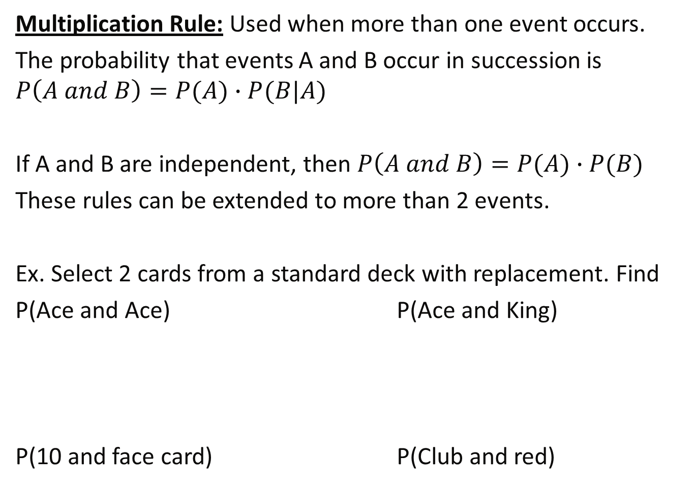
Multiplication Rule: Used when more than one event occurs.
The probability that events A and B occur in succession is $P\left(A and B\right)=P(A)∙P(B|A)$
If A and B are independent, then $P\left(A and B\right)=P(A)∙P(B)$
These rules can be extended to more than 2 events.
Ex. Select 2 cards from a standard deck with replacement. Find
P(Ace and Ace) P(Ace and King)
P(10 and face card) P(Club and red)

Slide 9
Ex. Select 2 cards from a standard deck without replacement. Find
P(Ace and Ace) P(Ace and King)
P(10 and face card) P(Club and red)

Slide 10
Ex. Given the following table, answer the following questions.
What is the probability that a randomly selected student is taking class in the AM?
Given that a randomly selected student is taking class in the AM, what is the probability that they are taking 12 credits?
Time/Credits | 12 | 15 | 18
AM | 30 | 20 | 100
PM | 50 | 60 | 40

Slide 11
c. Given that a randomly selected student is taking 18 credits, what is the probability that they are in the PM?
d. Are taking 12 credits and taking class in the AM independent or dependent? Justify your answer mathematically.

